Slide 1
EdZuban.AI
Group members:
Warda Najam (20K-0310)
Hira Asif (20K-0337)
M Minhal Manjee (20K-0467)
Supervisor: Dr. Jawwad Shamsi

Slide 2


Problem Statement - Use case
More than 70% of students lacking English as their medium of instruction.(Bulletin of Education and Research April 2018, Vol. 40, No. 1 pp. 39-56)
E-learning platforms like Coursera and Udemy primarily offer content in English
IPARHAI is covering syllabus of inter board as well, to assist students it needs to provide educational content both in English and Urdu along with captions.

Slide 3
Product Features :
Translation to Urdu ✅
Lip Syncing ✅
Personalization ✅

Slide 4
Methodology
01
Input Video - Audio extraction using MoviePy
04
Add personalization to translation using video caption as input
02
Transcribe speech-to-text using OpenAI Whisper in English
05
Extract translated audio and muted original video using MoviePy
03
Translate to Urdu and than convert text-to-speech using gTTS
06
Lip Re-animation using Wav2Lip + LipGan, that takes in video and audio

Slide 5
Personalization
01
Text Preprocessing - tokenization using NLTK
04
Cosine Similarity Function - Embedding vs .xlsx file
02
Latent Dirichlet Allocation (LDA) - Probabilistic Method
05
Llama - 2 - Displaying Explanation
03
BERT-based model (bert-base-nli-mean-tokens) - Embeddings

Slide 6
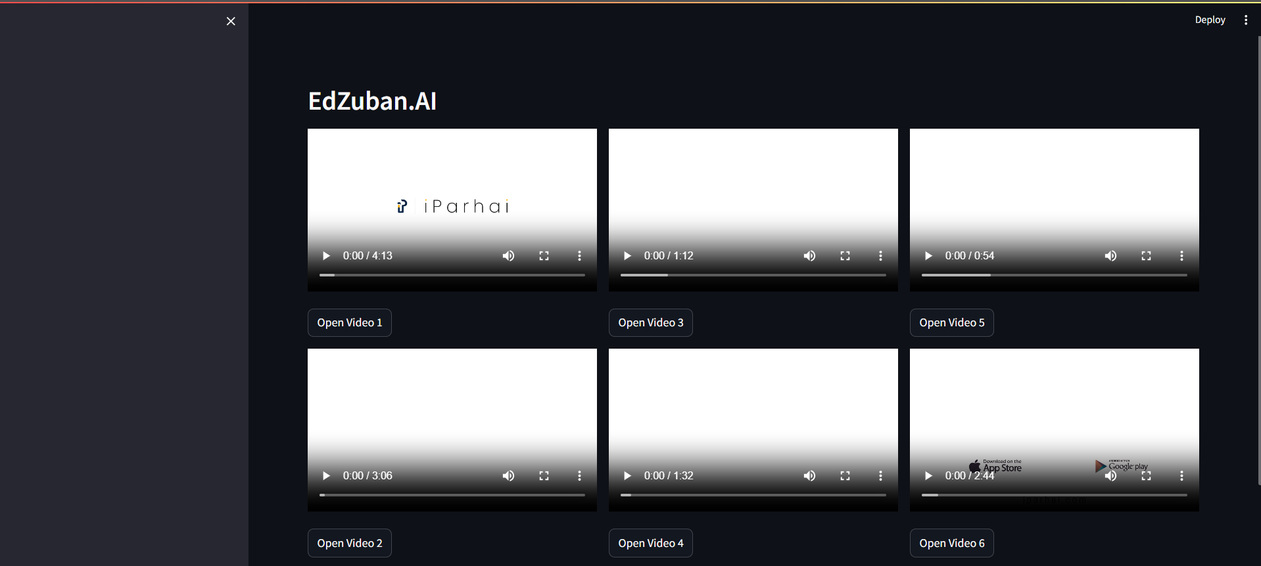
EdZuban.AI - UI

Slide 7
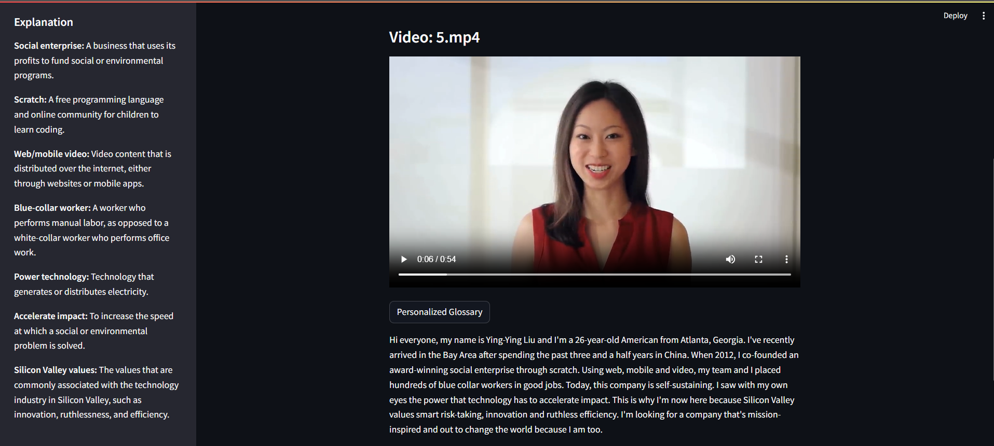
EdZuban.AI - UI

Slide 8
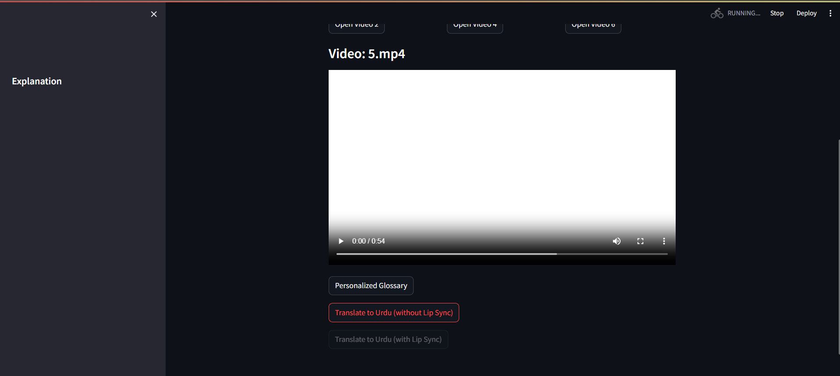
EdZuban.AI - UI

Slide 9
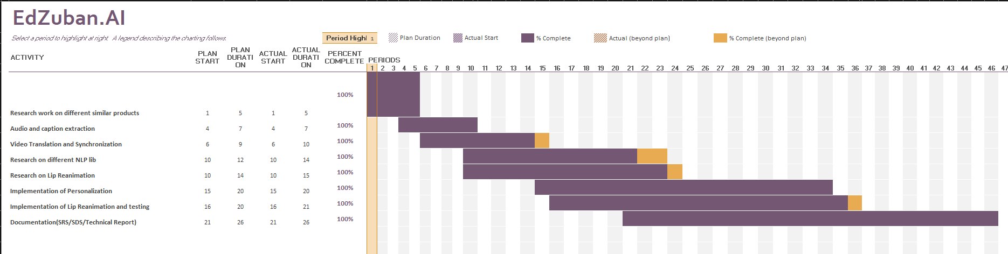
FYP -TimeLine

Slide 10
Thanks!
Do you have any questions?

